Slide 1
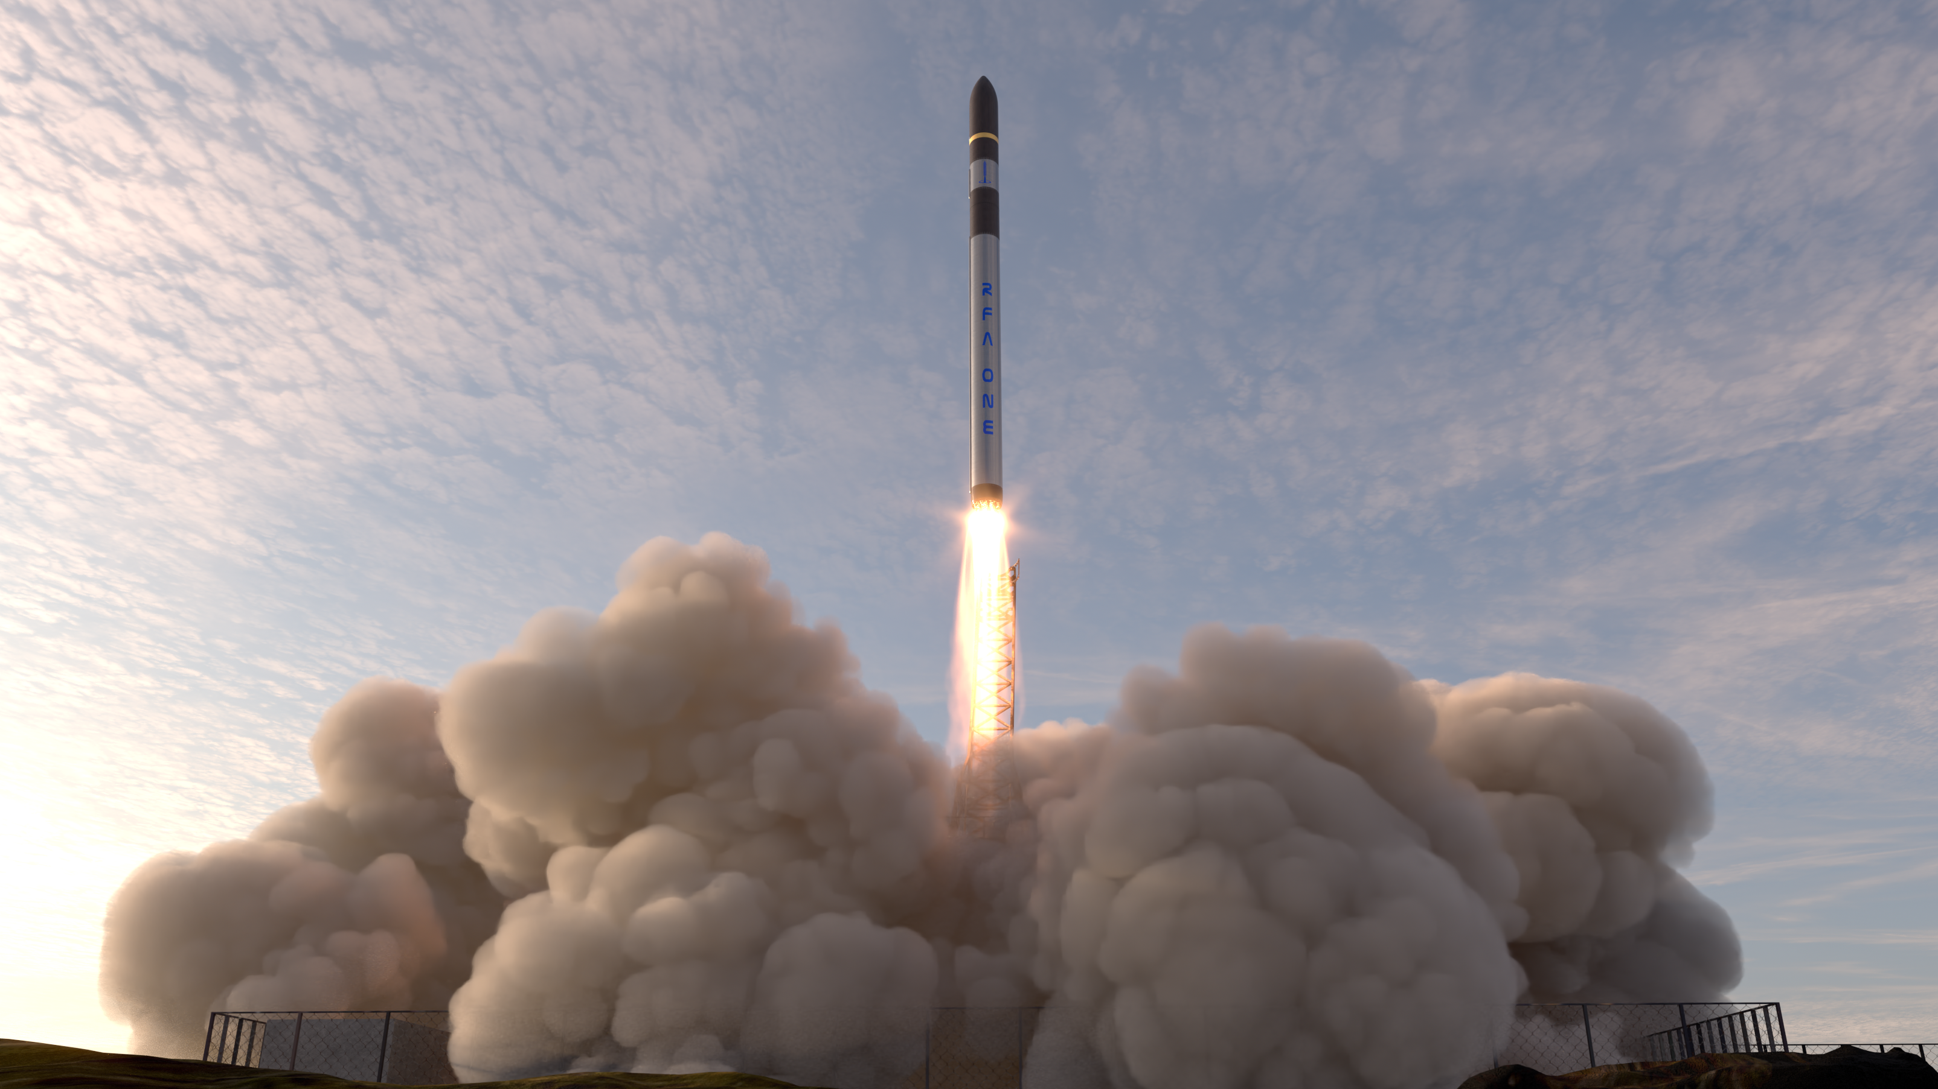

Rocketoptimizer
testrun 21.06.2024

Slide 2
Tasks from last time
Built tank pressure estimator (numerical)
Built cost calculator
Conducted test runs for RFA ONE for three different materials
+1 intern hired (in total four interns soon)

Slide 3
Trajectory optimizer Infrastructure (automatic loop)
implemented
Implemented with defaults
Not implemented
Database
(Nests like)
vehicle generator.py
initial trajectory guess generator.py
First Astos run.py
tools
i = 0
helpers
Odin
ASTOS input modifyer
Astos powershell run.py
Relevant_data_from_ASTOS.py
Odin input generator.py
Rocket_geometry_estimator.py
qmax_alpha calculator.py
i = i + 1
no
residuum(i) < epsilon
tankpressure calculator.py
loadcase tool.py
Loadcase input generator.py
Dynamic database
yes
Optimized vehicle

Slide 4
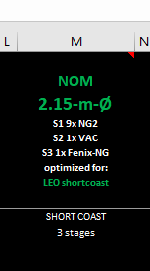
Baseline vehicle: RFA NOM V85_COL_M
RFA ONE NOM (V85_col_M):
S1: - dry mass: 8841 kg
- filled propellant: 96829 kg
- residual propellant: 912 kg
- vacuum Isp: 322 s
- vacuum thrust: 0 - MECOs: 1547 kN (100% throttle)
throttle)
- sea level thrust at takeoff: 1368 kN
- engine nozzle exit area (all 9 engines): 1.8 m^2
S2: - dry mass: 1624 kg
- filled propellant: 12082 kg
- residual propellant: 65 kg
- vacuum Isp: 349 s
- vacuum thrust: 0s - Seco: 97.12 kN (100% throttle)
- engine nozzle exit area : 1.09 m^2
S3: - dry mass: 327 kg
- filled propellant: 599 kg
- residual propellant: 8 kg
- vacuum Isp: 305 s
- vacuum thrust: 0s - insertion: 1.6 kN (100% throttle)
- engine nozzle exit area: 0.067 m^2
target orbit: 500km SSO, 97.43° incl. From SaxaVord

Slide 5
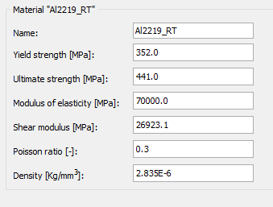
ALUMINUM
Alu 6061 T6 = yield strength at 250 MPa.
formula for Mises stress in pressure vessel:
sigma_mises = (0.86 * p * r_tank) / t.
p in MPa: 6.9 bar = 0.69 MPa =
t in mm
t = (0.86*p*r_tank)/sigma_mises
S1: t >= 2.3mm wall thickness
S2: t >= 2.3mm wall thickness
Name | Al6061T6
Yield strength [Mpa] RP02 | 276
Ultimate strength [Mpa] Rm | 310
Modulus of elasticity e [Mpa] | 70000
Shear modulus [Mpa] | 26000
Poisson ratio [-] | 0.33
density [kg/m^3] | 2.7e-6
Current values in Odin
Future values in Odin
No manufacturing minimum considered here !
https://asm.matweb.com/search/SpecificMaterial.asp?bassnum=ma6061t6

Slide 6
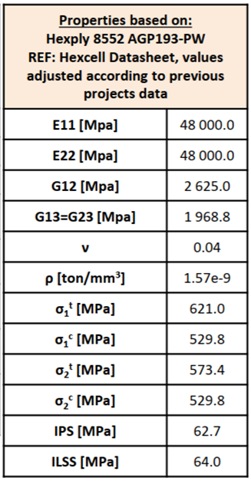
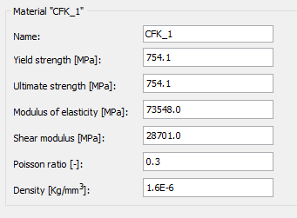
Carbon
No manufacturing minimum considered here !
=> S1: t >= 1-1.5mm wall thickness
=> S2: t >= 1.5-2mm wall thickness
Name | Cb
Yield strength [Mpa] RP02 | 748.1
Ultimate tensile strength [Mpa] Rm | 845.24
Modulus of elasticity e [Mpa] | 48000
Shear modulus [Mpa] | 2625
Poisson ratio [-] | 0.04
density [kg/m^3] | 1.57e-6
Future values in Odin
Current values in Odin
Yield strength = sqrt(sigma_1_c^2+sigma_2_c^2)
Tensile strength = sqrt(sigma_1_t^2+sigma_2_t^2)

Slide 7
Stainless Steel half hard
Name | St
Yield strength [Mpa] RP02 | 870
Ultimate strength [Mpa] Rm | 1190
Modulus of elasticity e [Mpa] | 200
Shear modulus [Mpa] | 77
Poisson ratio [-] | 0.3
density [kg/m^3] | 7.9e-6
- Stainless steel half hard: yield at 750 Mpa
S1: t >= 1.0-1.2mm wall thickness for half hard
S2: t >= 1.0-1.2mm wall thickness for half hard
No manufacturing minimum considered here !
t = (0.86*p*r_tank)/sigma_mises
Future values in Odin
https://matmatch.com/materials/mitf926-aisi-316l-half-hard

Slide 8
Optimizer assumptions
Fixed rocket diameter in S1, S2, S3
Fixed nr. of engines and thrust in S1, S2, S3
Fixed OTV tank size and structure mass
Fixed max. AoA (7°) at maxq => ca. 200 kPa° at maxq
Fixed T/W ratio lower bound at lift-off: 1.2
Fixed carbon interstage
Variable tank materials in S1, S2
Variable tank langth S1, S2
Variable wall thickness S1, S2
Safety factor for buckling + compression: 1.2 in S1, S2

Slide 9
Cost assumptions
Manufacturing (based on NESTS):
Engine : 2280 €/kN thrust*1.6*1.26
Steeltank: 200 €/kg
Aluminumtank: 400 €/kg
CFK tank: 800€/kg
Interstage ATG: TBD => real quotes ask procurement
Material:
Kerolox: 2 €/kg mass
Aluminumtank: 2.5 €/kg mass
Steeltank: 2.65 €/kg mass
Cfktank: 30 €/kg mass
OTV based on (NESTS):
640.000 €
Fairing:
50.000 € => not up to date

Slide 10
Results
Constant values
Optimized values
RFA ONE S1:SS, S2:SS, S3:CC
S1: - dry mass: 5371 kg
- filled propellant: 95730 kg
- residual propellant: 912 kg
- vacuum Isp: 322 s
- vacuum thrust: 0 - MECOs: 1547 kN (100% throttle)
- sea level thrust at takeoff: 1368 kN
- engine nozzle exit area (all 9 engines): 1.8 m^2
- wall thickness: 0.561 mm
- sigma: 0.01368
- tank pressure: 4.3 bara
S2: - dry mass: 1249 kg
- filled propellant: 10553 kg
- residual propellant: 65 kg
- vacuum Isp: 349 s
- vacuum thrust: 0s - Seco: 97.12 kN (100% throttle)
- engine nozzle exit area : 1.09 m^2
- wall thickness: 0.689 mm
- sigma: 0.0336
- tank pressure: 5.25 bara
S3: - dry mass: 327 kg
- filled propellant: 599 kg
- residual propellant: 8 kg
- vacuum Isp: 305 s
- vacuum thrust: 0s - insertion: 1.6 kN
- engine nozzle exit area: 0.067 m^2
RFA ONE S1:CC, S2:CC, S3:CC
S1: - dry mass: 4344 kg
- filled propellant: 95739 kg
- residual propellant: 912 kg
- vacuum Isp: 322 s
- vacuum thrust: 0 - MECOs: 1547 kN (100% throttle)
- sea level thrust at takeoff: 1368 kN
- engine nozzle exit area (all 9 engines): 1.8 m^2
- wall thickness: 0.648 mm
- sigma: 0.0031
- tank pressure: 4.3 bara
S2: - dry mass: 929 kg
- filled propellant: 11289 kg
- residual propellant: 65 kg
- vacuum Isp: 349 s
- vacuum thrust: 0s - Seco: 97.12 kN (100% throttle)
- engine nozzle exit area : 1.09 m^2
- wall thickness: 0.795 mm
- sigma: 0.00713
- tank pressure: 5.25 bara
S3: - dry mass: 327 kg
- filled propellant: 599 kg
- residual propellant: 8 kg
- vacuum Isp: 305 s
- vacuum thrust: 0s - insertion: 1.6 kN
- engine nozzle exit area: 0.067 m^2
S1:Al, S2:Al, S3:CC
S1: - dry mass: 5038 kg
- filled propellant: 95688 kg
- residual propellant: 912 kg
- vacuum Isp: 322 s
- vacuum thrust: 0 - MECOs: 1547 kN (100% throttle)
- sea level thrust at takeoff: 1368 kN
- engine nozzle exit area (all 9 engines): 1.8 m^2
- wall thickness: 1.38 mm
- sigma: 0.01025
- tank pressure: 4.26 bara
S2: - dry mass: 1152 kg
- filled propellant: 10772 kg
- residual propellant: 65 kg
- vacuum Isp: 349 s
- vacuum thrust: 0s - Seco: 97.12 kN (100% throttle)
- engine nozzle exit area : 1.09 m^2
- wall thickness: 2.96 mm
- sigma: 0.0256
- tank pressure: 5.25 bara
S3: - dry mass: 327 kg
- filled propellant: 599 kg
- residual propellant: 8 kg
- vacuum Isp: 305 s
- vacuum thrust: 0s - insertion: 1.6 kN
- engine nozzle exit area: 0.067 m^2
7.699.598 € cost
7.676.255 € cost
7.868.531 € cost
2274 kg payload mass => 3385 €/kg
2676 kg payload mass
=> 2868 €/kg
2395 kg payload mass => 3285 €/kg

Slide 11
Next actions
refine cost database (include diameter and length of tanks)
Include interstage optimization (Odin bugs here)
Implement better output report

Slide 12
Rocketoptimizer
update 09.09.2024

Slide 13
NEW Portugal prices included
All previous tasks accomplished
Fixed some bugs, removed unnecessary assumptions
Implemented better output report

Slide 14
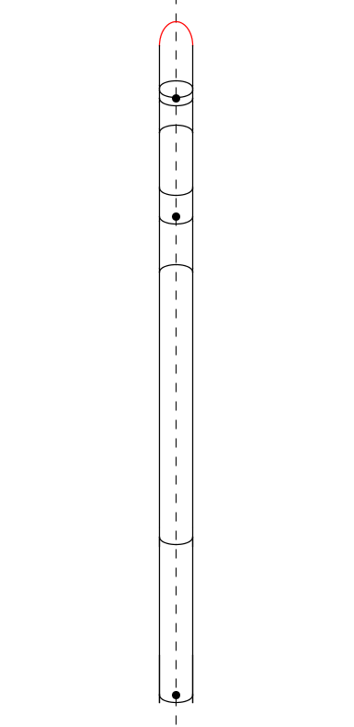
What’s optimized
Stage 3:
- Not optimized
Fairing:
- Not optimized
Interstage 2:
- Thickness optimized
Stage 2 tanks:
Thickness optimized
Length optimized
Interstage 1:
- Thickness optimized
Stage 1 tanks:
Thickness optimized
Length optimized

Slide 15
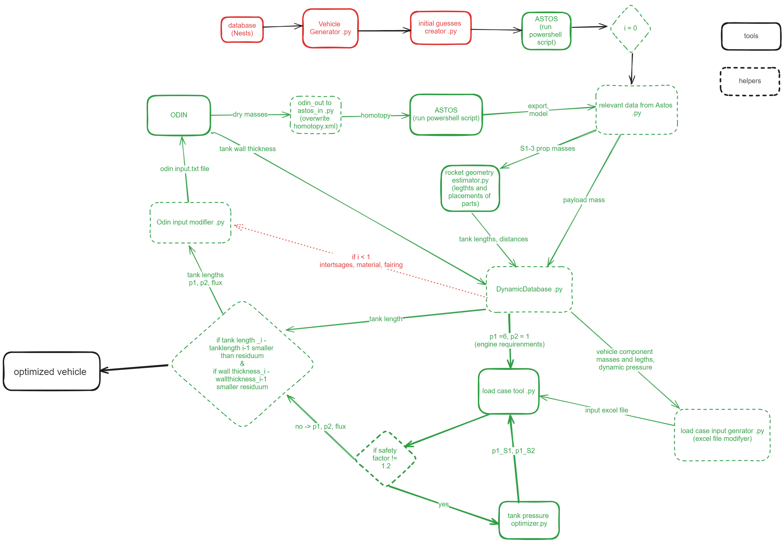

Slide 16
Assumptions
Safety factor 1.8 (otherwise small wall thicknesses which aren’t manufacturable)
Bending moment safety factor is 1.2
O/F ratio is 2.63
Fixed rocket diameter in S1, S2, S3
Fixed nr. of engines and thrust in S1, S2, S3
Fixed OTV tank size and structure mass
Interstage material is carbon

Slide 17
Price assumptions
Stainless steel: 200€/kg
Aluminum: 400€/kg
Carbon: 2200/kg
KeroLox: 2€/ kg
OTV: 640000€
Fairing: 50000€

Slide 18
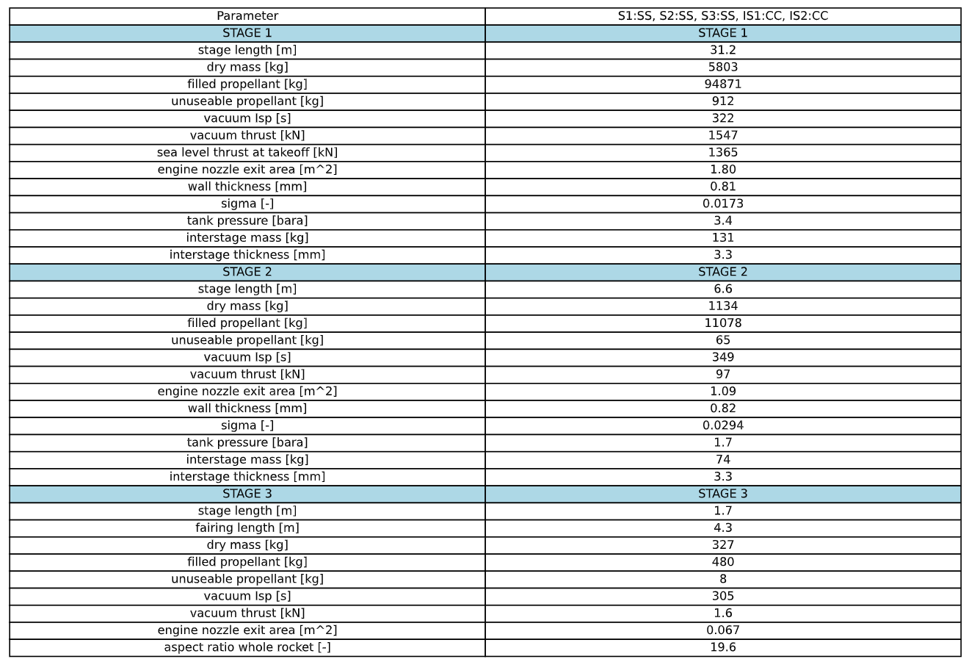
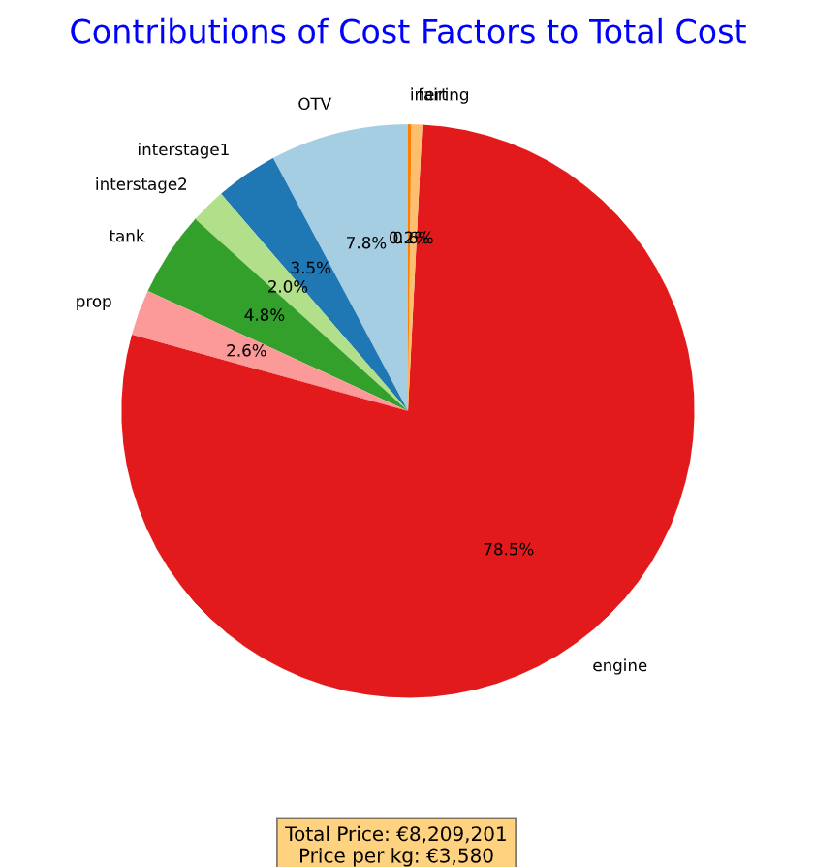
Stainless steel Configuration (portugal prices)
2293.07 kg payload

Slide 19
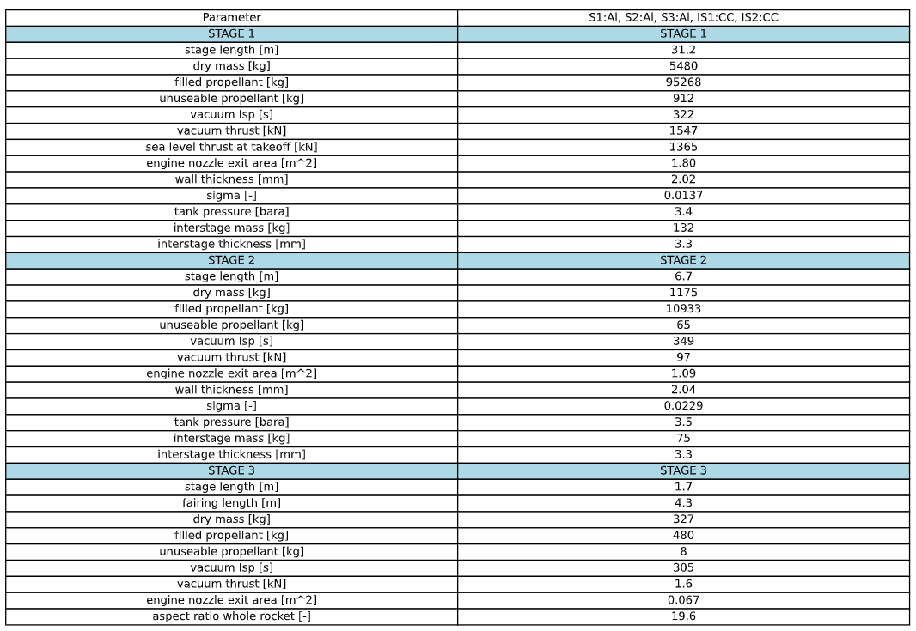
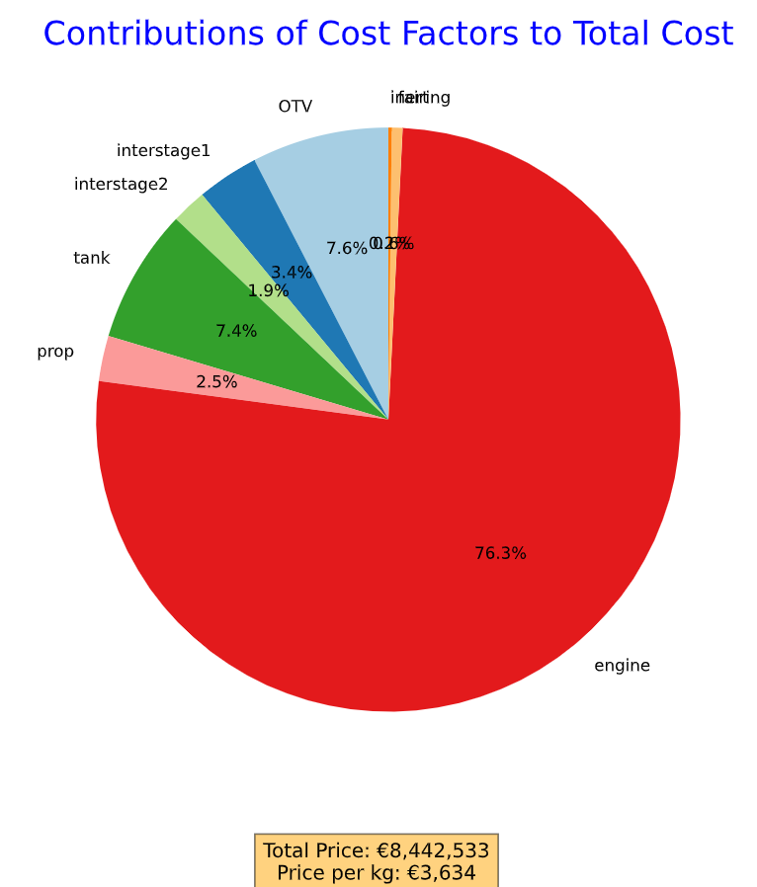
AL configuration (Portugal prices interstages)
2323.2 kg of payload

Slide 20
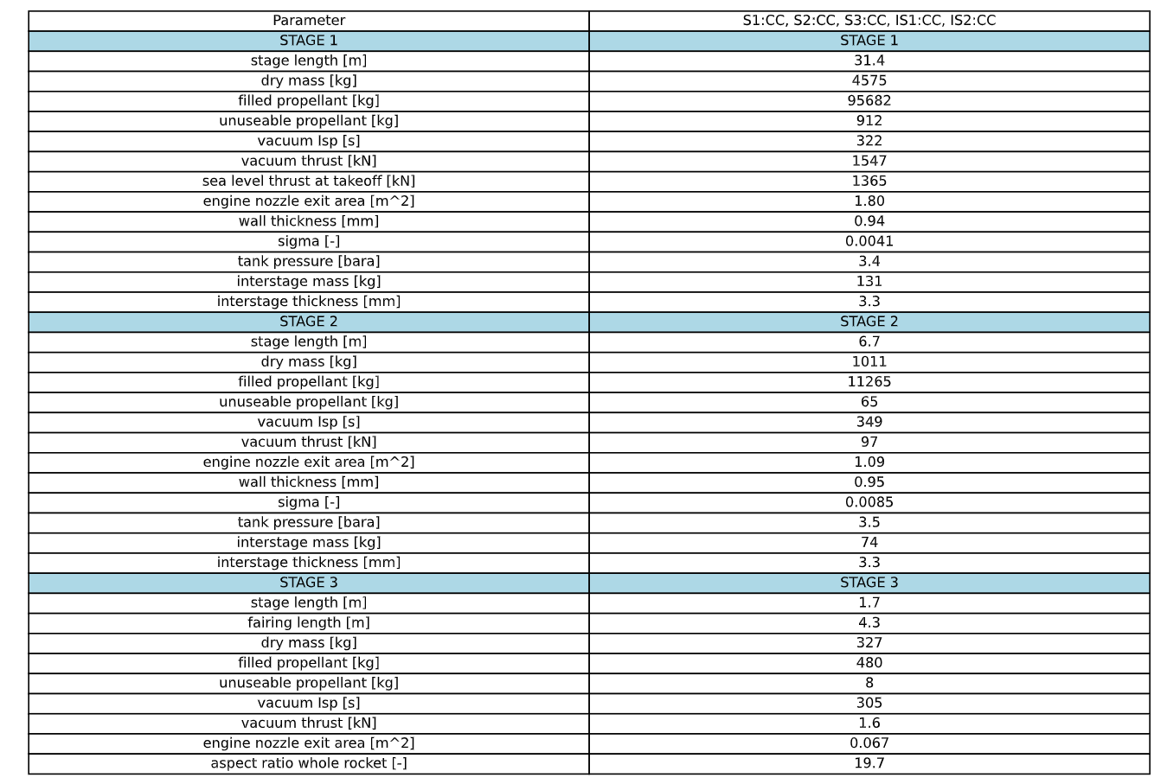
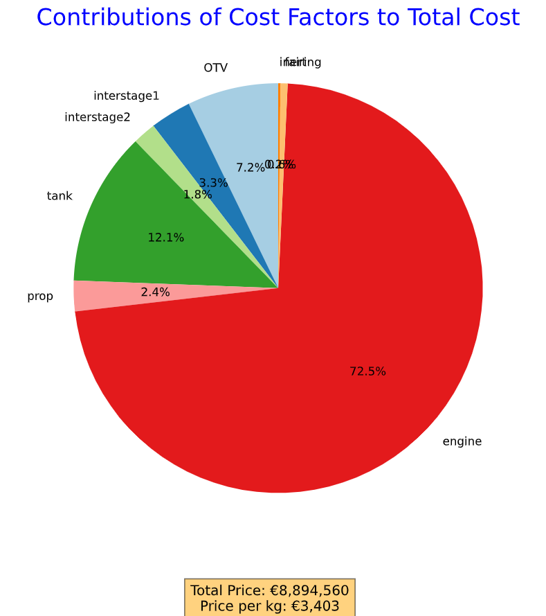
CC configuration (Portugal prices interstages)
2613.7 kg of payload

Slide 21
Next steps
Create database with various kind of combinations
Automise picking a vehicle and running the loop
Define a proper residuum

Slide 22
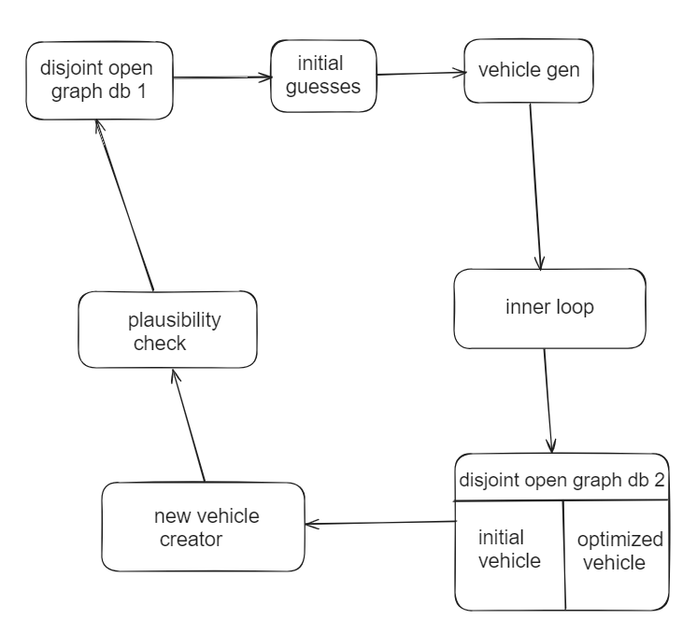
Enhanced infrastructure
j
iterations

Slide 23
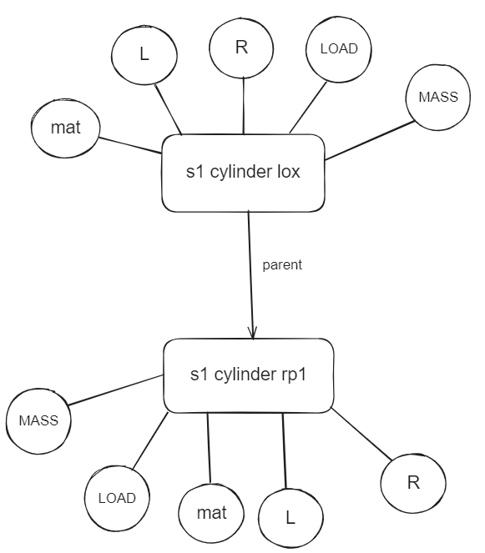
databases
db1 includes initial configurations in the
beginning -> manually or random added
db2 filled with all configs from db1
together with their optimized version
produced by inner loop
After j > 1 iterations db1 contains
optimized versions from prev. loop

Slide 24
Initial guesses
based on Phd thesis using guidance laws (https://elib.uni-stuttgart.de/bitstream/11682/3672/1/Markl_Al.pdf)
Creates initial trajectory guess

Slide 25
Vehicle generator
Creates Odin input .txt from knowledge of database
Several fixed parameters to reduce database size resulting in decreasing computational effort of new vehicle generator

Slide 26
Inner loop
Shown previously
Maybe dynamically adjusted by price forecasting models, e.g. based on XGBoost
Further improvement by adjusting Astos runs per loop iteration and amount of iterations of Astos itself

Slide 27
New vehicle generator
GraphSAGE: https://snap.stanford.edu/graphsage/
GAT: https://arxiv.org/abs/1710.10903
O(N + E)
NVIDIA A100 or V100 are suited for very large-scale GNN tasks
-> AWS, GCP, …
For larger-scale projects with multiple GPUs or very large datasets, costs can go upwards of $50–$500, depending on the resources used. (Per j)

Slide 28
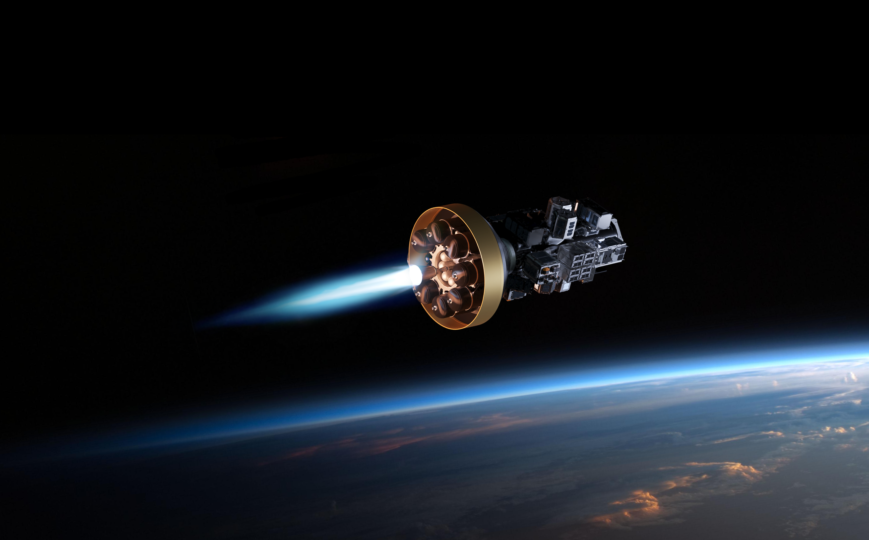




Thank you for joining our mission!
Follow us on Social Media!
Rocket Factory Augsburg - RFA
@rfa_space
@rfa.space
Rocket Factory Augsburg

